Slide 1



Slide 2

Overview
Data models
Schemata and instances
Database views
Data modeling
What is entity relationship model?
Entities, entity types and attributes
Relationships
Developing E-R diagrams
Relational model
Summary

Slide 3

Data models
Data models,
Are key to the design of database systems.
Way to organize data using set of rules

Slide 4
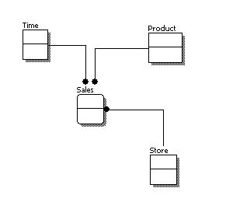
Conceptual data model
Sample conceptual data model

Slide 5

Type of data models
3 types ,
Conceptual (high level)data model
Implementation (representational)data model
Physical (low level) data model

Slide 6


Implementation data model
An intermediate level describing how the data is logically organized
Presented as a description of interface to the DBMS
Describe the data using relations and sets
Example : relational model and network model

Slide 7

Conceptual data model
High level model
Describes what is stored
Presented in the form of written documents
Describe data using high level concepts
Identify highest relationship
Example : UML and E-R diagrams

Slide 8
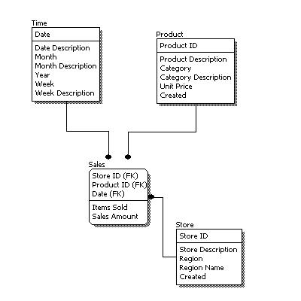
Implementation data model
Sample implementation data model

Slide 9

Comparison b/w 3 models
Compare the 3 models’ features
Feature | Conceptual | Implemental | Physical
Entity names
Entity relationships
Attributes
Primary keys
Foreign keys
Table names
Column names
Column data types

Slide 10

Physical data model
Very low level model
Describes how the data is physically stored
Expressed in the form of commands
Can define in the statements that create the database
Example : CREATE TABLE or CREATE INDEX

Slide 11
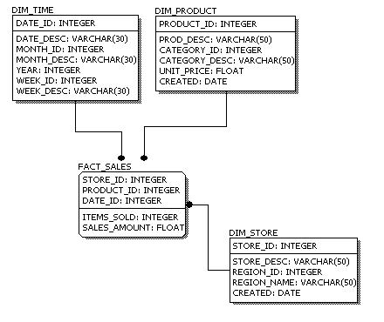
Physical data model
Sample physical data model

Slide 12

Types of schemata
Star schema
Snowflake schema

Slide 13

Schemata and instances
Both are the key concepts
Schema→ description of a database in some data model
Instance→ collection of data corresponds to s schema
    Comparison of database with programming language
schemata
datatypes
instances
variables

Slide 14
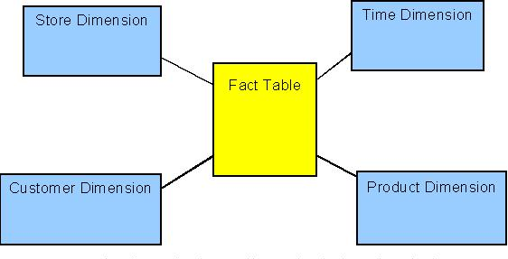


Star schema

Slide 15
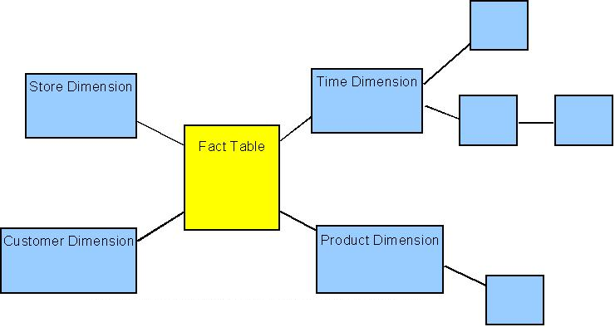

Snowflake schema

Slide 16

Instances
Data corresponds to schema
Also known as environment
Used to describe a complete database environment
Example : instances for student
MetricNo | Name | Registered | CouncellorNo
S01 | Bloggs | 2005 | 4523
S02 | Smith | 2003 | 3412
S03 | MacDonald | 2004 | 4523

Slide 17


Database views
A database view is a type of schema that sits a level above the actual schema and controls what the user can see. Such views are often referred to as external schemas
Reasons for using views
  Restricting access
  Generating data

Slide 18


Restricting access
Since you do not want all users to be able to access all data.
Example: bank database

Slide 19

Generating data
This is a common technique in database systems. It is not always necessary to store items of data that can be generated from other items of data in the database
Example : the age of a person can be calculated from their date of birth

Slide 20



Slide 21

Data modeling
Data modeling is a technique that is widely used in the world of business and information technology to show how information is, or should be, stored and used within a business system.

Slide 22
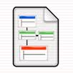

Entity relationship model
Well established approach to the design of database system
Focus of the technique is on the data and relationship b/w the data
Is a conceptual level data model

Slide 23
Entity example
Textually , Student(MatricNo, Name, Registered)
Identifier is shown underlined which is used to distinguish one entity from another
student

Slide 24
Relationships
A relationship is an association between entities that needs to be recorded.
The above relationship concerns the “counseling” relationship between the entity types
counsels
Staff
Student

Slide 25
Entities, Entity Types and Attributes
  An entity represents a thing about which data is recorded. An entity may represent a tangible object, such as a student (John Perkins) or a vehicle (A 34761). It can often represent intangible objects, such as enrolment or order.
  An entity type defines the properties of a collection of entities. For example, a Student with Name, Matriculation Number and Date of Registration.
  An attribute is a component of an entity that represent a single property of entities of that type. The attributes of the student entity type are Name, Matriculation Number and Date of Registration.

Slide 26
Degree of relationship
The degree of a relationship governs the maximum number of entities that participate in the relationship.
1:1: This is referred to as a one to one relationship
1:N: This is referred to as a one to many relationship
M:N: This is referred to as a many to many relationship.
Staff
heads
Department
Person
owns
car
Course
Taught at
Location

Slide 27
Degree of relationship
A relationship may exist between different entities of the same type.
The above relationship is shown to be married to, which captures the fact that one instance of the Person entity may be married to another instance of the Person entity.
Married to
Staff

Slide 28
Developing E-R diagrams
The relational model is concerned with what is required, which separates it from concerns of how the model will be implemented. The how is the concern of the relational DBMS.
The relational model focuses on representing data through relationships held between those data items. Data is represented in the form of tuples. The data in the relational model is queried/manipulated using relational algebra.
The data from the relational data model is represented in the form of tables and rows. The data is queried using particular query languages, most commonly this is a language known as SQL.

Slide 29
Developing E-R diagrams
Lets develop a E-R diagram with university as sample.
Identify potentials
  Student
  Staff
  Course
  Assignment
Identify attributes
  Student(MatricNo, Name, Registered, CourseCode)
  Staff(StaffNo, Name)
  Course(CourseCode, Title, Credit, tutor)
  Assignment(MatricNo, CourseCode, AssignmentNo, Grade)

Slide 30
Developing E-R diagrams
Choose identifiers
  Student(MatricNo, Name, Registered, CourseCode)
  Staff(StaffNo, Name)
  Course(CourseCode, Title, Credit, tutor)
  Assignment( MatricNo, CourseCode, AssignmentNo, Grade)
Candidate identifiers are shown by underling the attribute - remember that multiple attributes may be involved in forming the identifier.

Slide 31
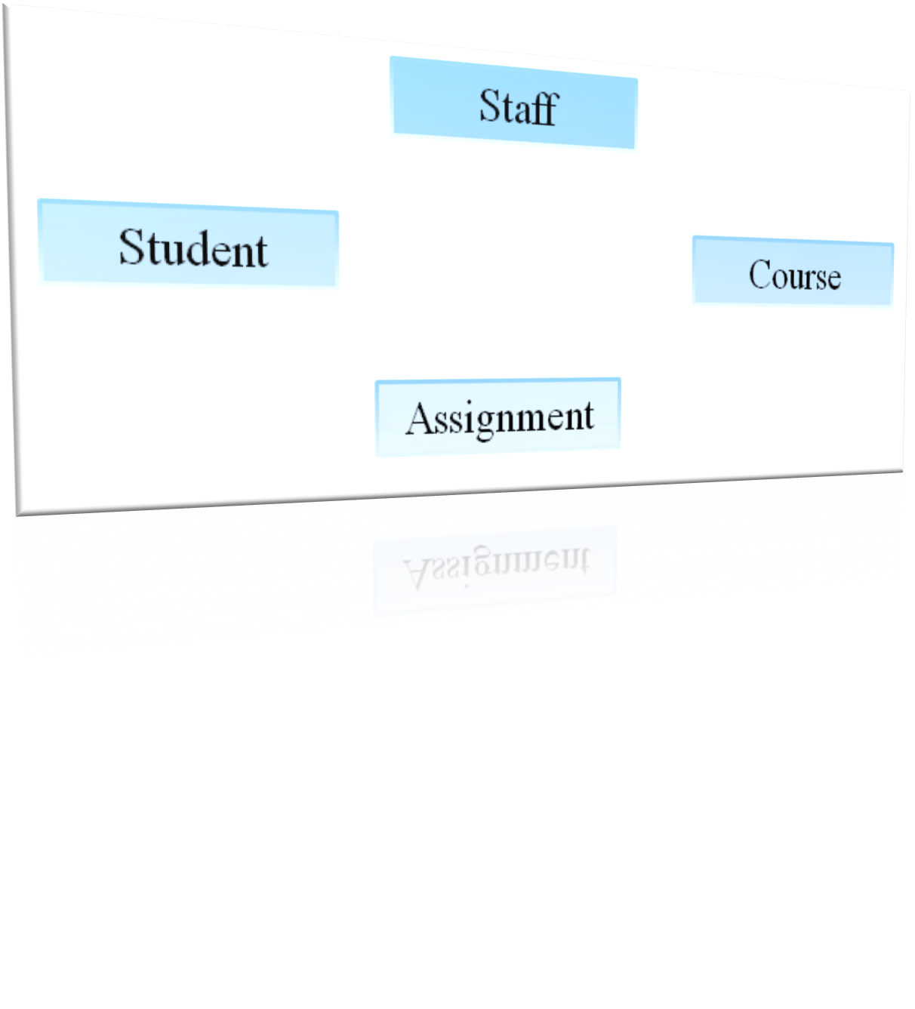
Developing E-R diagrams
Draw initial E-R diagram

Slide 32
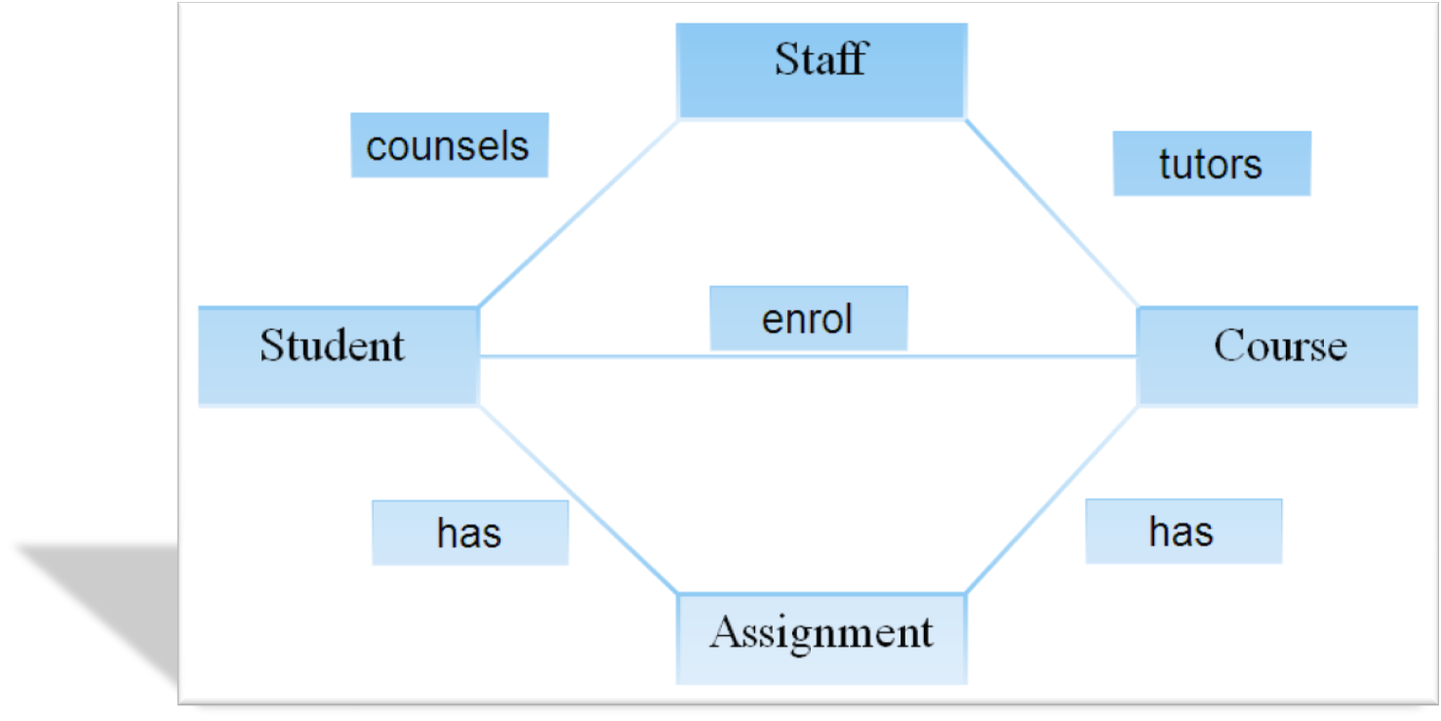
Developing E-R diagrams
Add Relationship Information: Referring to the text description, draw relationships between the entities on the draft ER diagram.

Slide 33
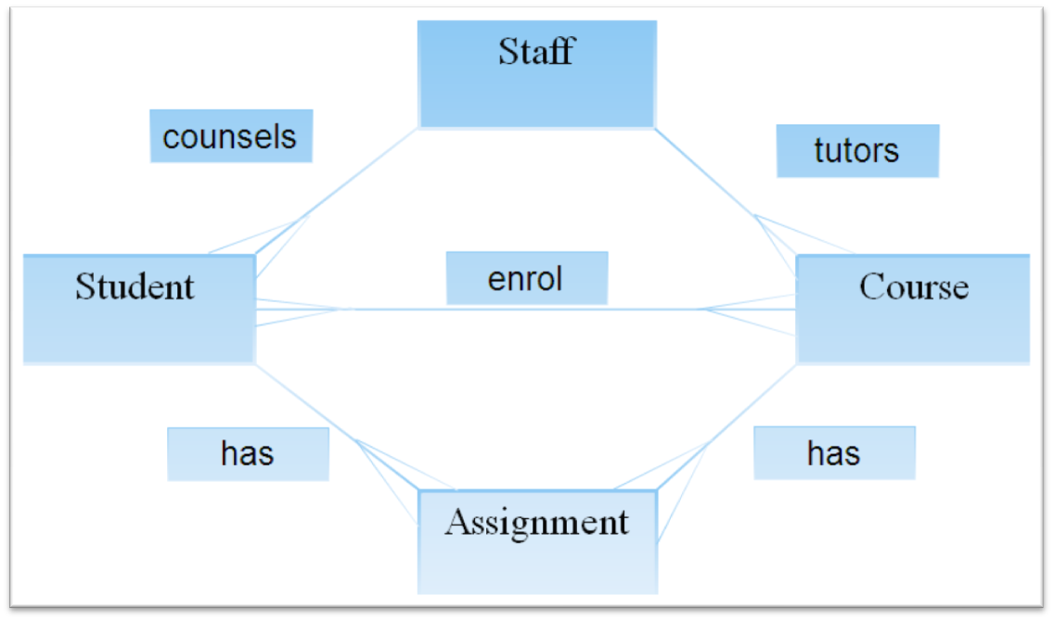
Developing E-R diagrams
Add Degree Information: From the text information, identify any additional information concerning the degree of relationships between entities. Add this information to the draft ER diagram.

Slide 34
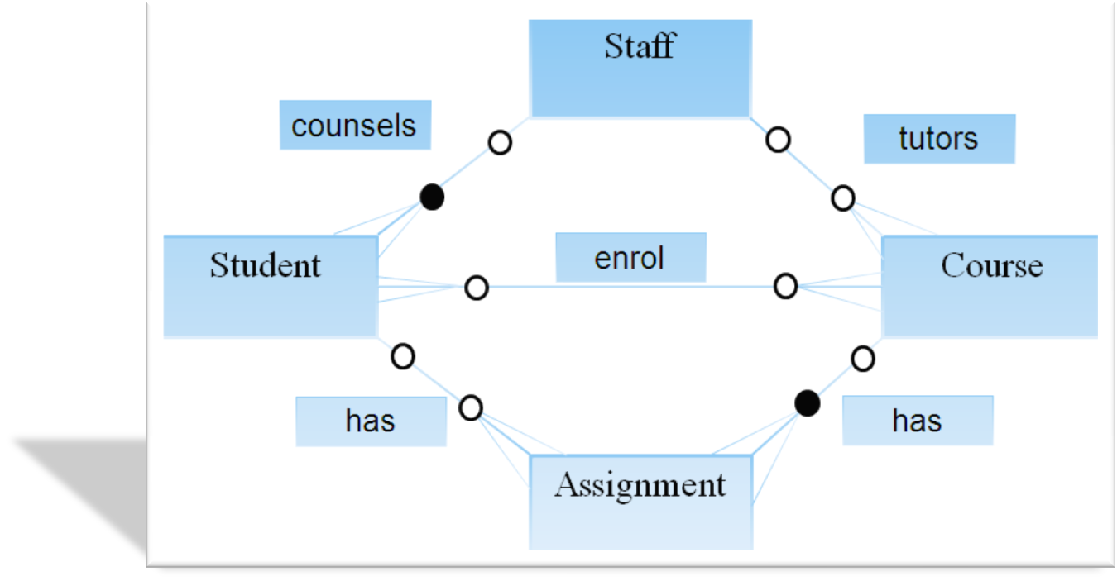
Developing E-R diagrams
Add Participation Information: From the text information, identify any additional information concerning the participation of entities in the relationships identified. Add this information to the developing ER diagram

Slide 35
Developing E-R diagrams
Constraints and Assumptions(Compile these as you are building the model)
  No of students registered for a course cannot exceed the course quota
  Students cannot enroll for more than 100 credits
  An assignment cannot exit without being part of a course.
  If a student is not registered for a course then they have no assignments.
  An assignment can only be for one course.
  A course can only have one tutor.

Slide 36
Developing E-R diagrams
Now we need to check if we are happy with our entities or should we redesign and remove the many to many relationships
As far as the university ER model is concerned this leads us to consider Enrolment as our final entity.
The full list of entities is therefore as follows:
Student
Staff
Course
Assignment
Enrolment

Slide 37
Developing E-R diagrams
Identify attributes:
Student(MatricNo, Name, Registered)
Staff(StaffNo, Name)
Course(CourseCode, Title, Credit, tutor)
Enrolment(MatricNo, CourseCode)
Assignment(MatricNo, CourseCode, AssignmentNo, Grade)

Slide 38
Developing E-R diagrams
Choose identifiers:
Candidate identifiers are shown by underling the attribute - remember that multiple attributes may be involved in forming the identifier.
Student(MatricNo, Name, Registered)
Staff(StaffNo, Name)
Course(CourseCode, Title, Credit, tutor)
Enrolment( MatricNo, CourseCode)
Assignment( MatricNo, CourseCode, AssignmentNo, Grade)

Slide 39
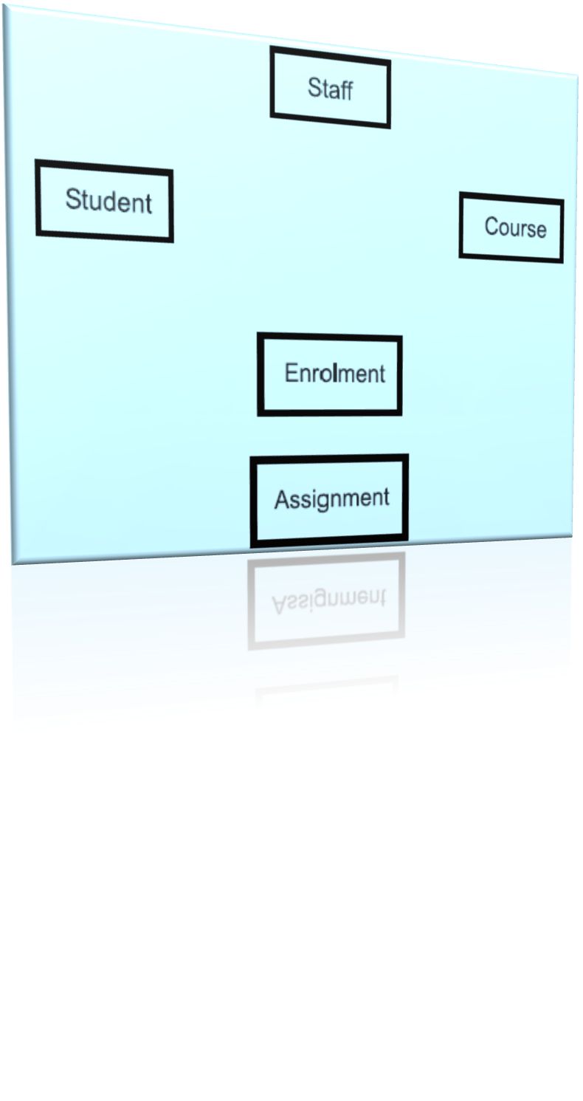
Developing E-R diagrams
Initial ER diagram

Slide 40
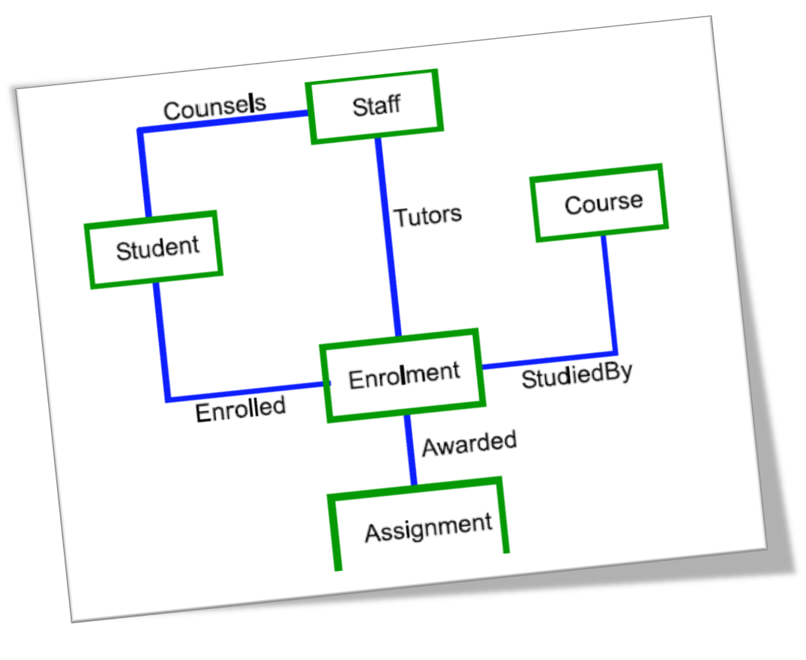
Developing E-R diagrams
Add Relationship Information: Referring to the text description, draw relationships between the entities on the draft ER diagram

Slide 41
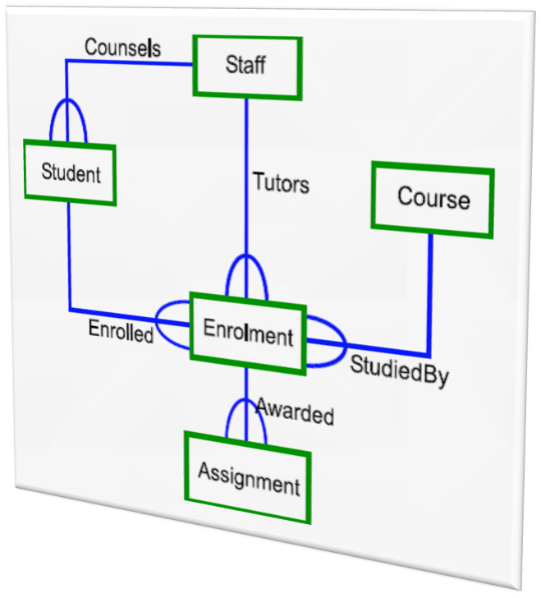
Developing E-R diagrams
Add Degree Information: From the text information, identify any additional information concerning the degree of relationships between entities. Add this information to the draft ER diagram.

Slide 42
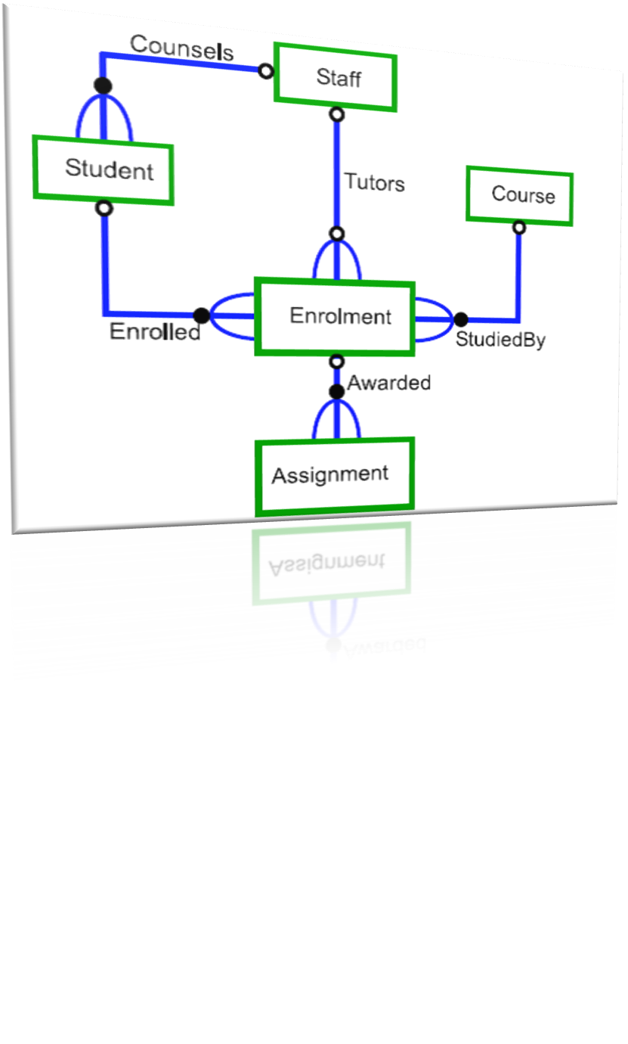
Developing E-R diagrams
Add Participation Information: From the text information, identify any additional information concerning the participation of entities in the relationships identified. Add this information to the developing ER diagram

Slide 43
Relational model
The relational model is concerned with what is required, which separates it from concerns of how the model will be implemented. The how is the concern of the relational DBMS.
  Focuses on representing data through relationships held between those data items.
  Data is represented in the form of tuples.
  The data in the relational model is queried/manipulated using relational algebra.
  The data from the relational data model is represented in the form of tables and rows.
  The data is queried using particular query languages, most commonly this is a language known as SQL.

Slide 44
Three parts of relational model
Structural
Manipulative
Constraints

Slide 45
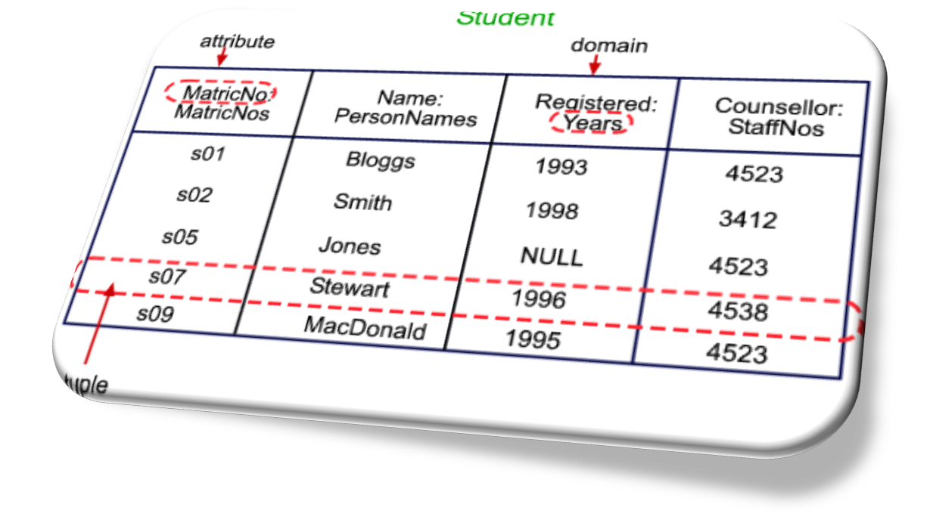
Structural
Defines the core of the data and the relationships involved. The model structure is described in terms of relations, tuples, attributes and domains.

Slide 46
Manipulative & constraints
Manipulative : defines how the data in the model will be accessed and manipulated. This concerns how relations in the model will be manipulated to produce other relations, which in turn provide the answer to some question posed by a user of the data. The manipulation is achieved though relational algebra.
Constraints: defines limits on the model. The constraints determine valid ranges and values of data to be included in the model.

Slide 47

Summary
This chapter has provided a detailed overview on,
Database models
Schemata and instances
Database views
Entity relationship model
Entities, entity types & attributes
Relationships
Developing ER diagrams
Relational model

Slide 48

Questions

Slide 49



